Slide 1

Introduction to Inkie.org
Library Name
Date

Slide 2



What is inkie.org?
Inkie.org is a suite of resources that
Supports Illinois authors with online book creation and publishing tools
  Pressbooks
Provides Illinois authors with an avenues to share their work
  Indie Author Project
Allows readers to access locally-produced content
  The Inkie.org Library
Available at no cost
to anyone in Illinois
Via the local library!
Notes:
What is inkie.org? So, inkie.org is a website, and on that website you will find
Inkie.org is a suite of resources that
Supports Illinois authors with online book creation and publishing tools
Pressbooks relatively straightforward editing and e-book creation software
Provides Illinois authors with an avenues to share their work
Indie Author Project This is an organization we partner with that allows self-published authors share work with readers here in Illinois and across the country.
Allows readers to access locally-produced content
The Inkie.org Library This is a library collection of e-content and self-published e-books by Illinois authors and creators.

Slide 3

Online Book Creation and Publishing Tools
Pressbooks
Online software that allows writers to create e-book files
Create an e-book in 5 steps
  Register for a Pressbooks account
  Add your book information
  Add and organize your text
  Select a design theme
  Export your e-book!
Access Pressbooks training resources and more via inkie.org
Notes:
Online Book Creation and Publishing Tools
Pressbooks
Online software that allows you to create e-book files
Create an e-book in 5 steps
Register for a Pressbooks account you do need an email account - that is one thing that is required
Add your book information Title, author, etc
Add and organize your text There is a text editor, you could write the whole thing right there in pressbooks
Select a design theme Font, chapter headings, etc.
Export your e-book! You can export the file as an e-pub, pdf, etc.
Access Pressbooks training resources and more via inkie.org You can always go back to the inkie.org website for more information, including links to the user manual, and instructional videos, etc.

Slide 4



Avenues to Share Work
Indie Author Project
Indie Author Project Select
  Submission portal available via inkie.org
Indie Illinois
  Via the Inkie.org Library and available to everyone in Illinois
Soon to Be Famous Illinois Author Project contests
  Novel contests
  De la Página a la Fama
  Manuscript contest
Notes:
Avenues to Share Your Work
Indie Author Project Is an initiative that supports self-published authors and libraries. They promote and host a collection of self-published e-books.
Indie Author Project Select A collection of e-books available via libraries across the country that are self-published. But they have been vetted by Library Journal and selected as best of the best self-published e-books. To get your book into the IAP Select collection, you need to submit it to the Indie Author Project. You can do that through the portal on inkie.org.
Indie Illinois That submission portal also grants your book admission into the Indie Illinois e-book collection. Indie Illinois is a collection of independently and self-published e-books by Illinois authors. They are available to read via the Inkie.org Library and they are available to everyone in Illinois.. And the submission portal is the same one at the IAP select portal.
Via the inkie.org library
Soon to Be Famous Illinois Author Project contests This was a contest that was started in 2013 by library professionals who wanted to support self-published authors and showcase the power of libraries. It has since gone nation-wide - the IAP has been very involved, there are contests in 13 states and a Canadian province, and now a national contest of statewide winners. If you win the Illinois contest, you are entered into the nationwide contest
Novel contest 2 categories for the novel contest - self-published adult fiction and young adult fiction. Winners receive a cash prize, recognition, inclusion in a full-page print spread in Library Journal, opportunities and events to promote your work, and you are automatically entered in the national contest.
De la Página a la Fama This is a new contest - 2021 was the first year it was held - for the best self-published work in Spanish. Like the novel contest you win a cash prize, recognition and opportunities to promote your book, inclusion in the full page print spread in Library Journal, etc.
Manuscript contest This contest is for a work of fiction that has not been published, not finished yet. Because what you win is line editing services, professional cover design, as well as support and recognition. And when you do self-publish your book, it is automatically entered as a semi-finalist in the STBF contest the next year.

Slide 5

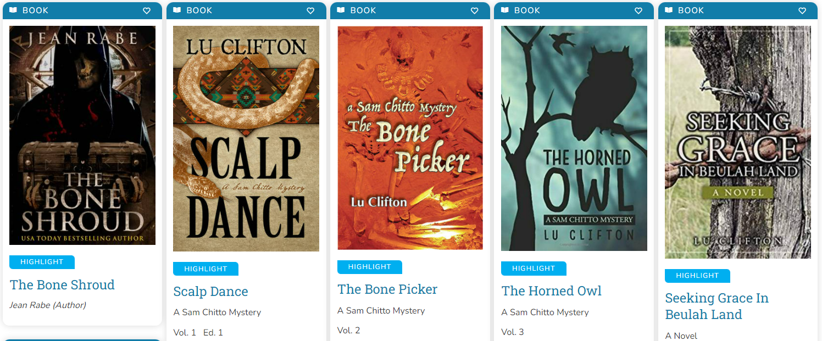

Access Locally Produced Content
Inkie.org Library
Indie Illinois
RAILS Community Collections
Available to everyone in Illinois
  No login or library card required
Notes:
Access Locally Produced Content
Inkie.org Library This is a collection of e-content. It lives on a platform called BiblioBoard (so you may have heard of Overdrive, or Libby - similar, it’s just called BiblioBoard)
Indie Illinois I already mentioned this collection - these are self-published e-books by Illinois authors. This is the collection that you can add your e-books to. All sorts of e-books available from authors all over the state.
RAILS Community Collections The Inkie.org Library is also home to a collection of e-content that we call RAILS Community collections - these are collections that have been created by local libraries. They include things like historical photo collections, community cookbooks, writers’ group projects, etc. These are really fun collections to browse, I recommend checking them out
Available to everyone in Illinois And the good news is, you can do that! These materials are available to everyone in Illinois, you do not need a library card, you do not need to log in. There are no holds, no waiting - these materials are available to everyone all the time.
No login or library card required

Slide 6
Website Tour
Notes:
(Clicking on the inkie.org logo will take you to the inkie.org website where you can demonstrate all of the features you just talked about.)

Slide 7
To recap, inkie.org is a suite of resources that enables users to:
Create e-books
Share e-books with readers
Discover local authors, e-books, and creators
Available at no cost
to anyone in Illinois
Via your the library!

